Slide 1
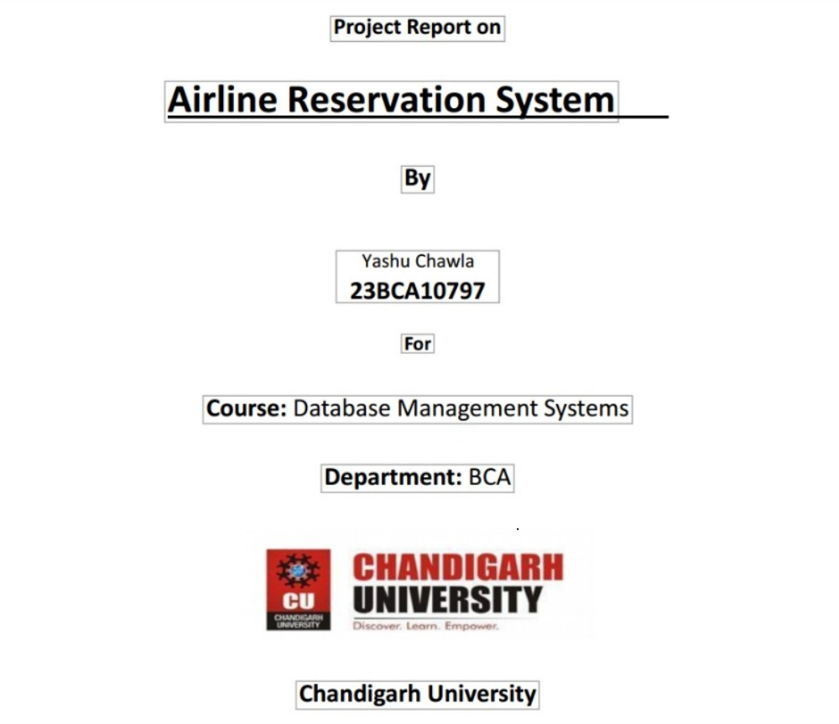

Slide 2
✈️ Airline Reservation Management System
🔹 Introduction
The Airline Reservation Management System is a database management project aimed at simplifying and organizing the process of booking and managing flight tickets. It maintains data related to flights, customers, bookings, payments, and seat availability. The system allows users to book tickets, view schedules, cancel bookings, and manage customer details in a structured way.
🔹 Objectives
Automate the airline booking process.
Efficiently manage customer and flight details.
Enable quick ticket booking and cancellations.
Maintain payment and schedule history.
Provide secure and accurate access to data.
🔹 Scope
Used by airlines, agents, and travelers.

Slide 3
Handles bookings, cancellations, and schedules.
Can be extended with payment gateways and loyalty programs.
Scalable for domestic and international flights.
🔹 Technology Used
Frontend: Optional (HTML/CSS/PHP/Java - not included here)
Backend: MySQL / PostgreSQL (SQL queries)
DBMS: Relational Database System (RDBMS)
Tools: MySQL Workbench, phpMyAdmin, Oracle SQL, etc.
🔹 ER Diagram Description
Entities:
Customer (CustomerID, Name, Contact, Email)
Flight (FlightID, Airline, Source, Destination, DepartureTime, ArrivalTime)
Booking (BookingID, CustomerID, FlightID, BookingDate, Status)

Slide 4
Payment (PaymentID, BookingID, Amount, PaymentDate, PaymentMode)
Seat (SeatID, FlightID, SeatNumber, IsAvailable)
Relationships:
A Customer can make many Bookings. (1:M)
A Flight can have many Seats. (1:M)
A Booking is associated with one Flight and one Customer.
A Payment is associated with one Booking.
Seat is a weak entity depending on Flight (as SeatID is unique only with FlightID)
.
🔹 Relationship Between Strong and Weak Entities
Strong Entity: Flight (has primary key FlightID)
Weak Entity: Seat (identified by SeatID and FlightID together)
The relationship is Flight ➡️ Seat, where Seat cannot exist without a Flight.

Slide 5
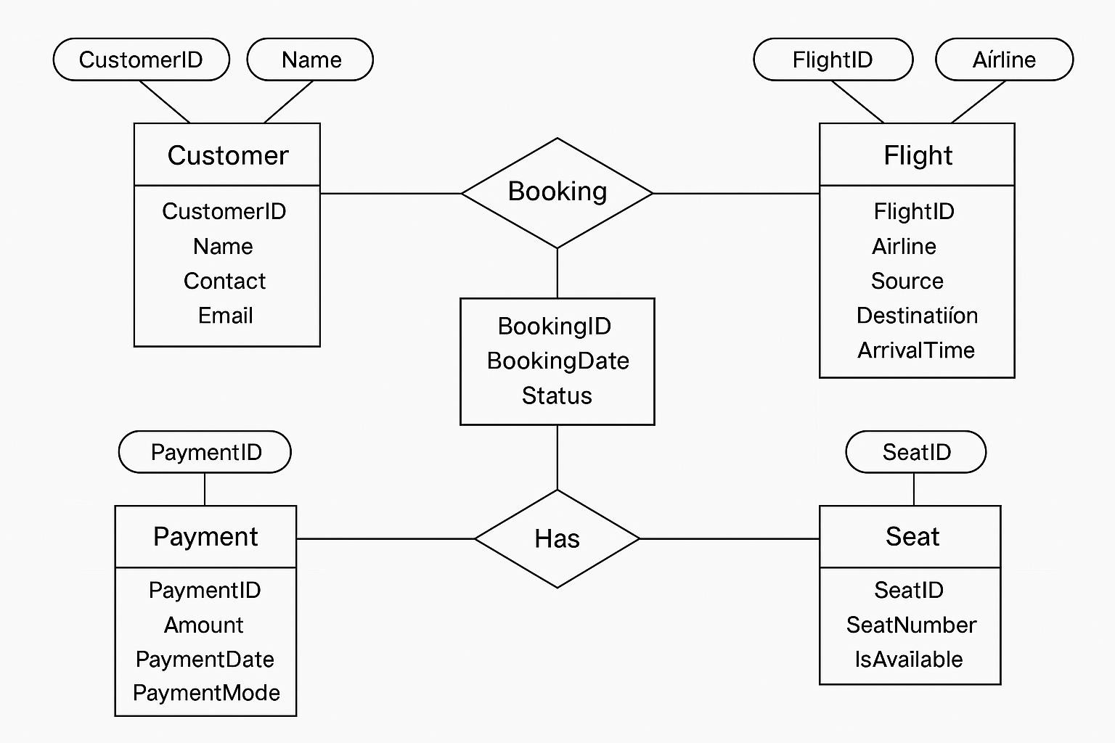
•
•
🔹 SQL Implementation
sql CopyEdit
-- 1. Create Customer Table CREATE TABLE Customer (
CustomerID INT PRIMARY KEY, Name VARCHAR(100),

Slide 6
Contact VARCHAR(15), Email VARCHAR(100)
);
-- 2. Create Flight Table CREATE TABLE Flight (
FlightID INT PRIMARY KEY,
Airline VARCHAR(100), Source VARCHAR(50),
Destination VARCHAR(50),
DepartureTime DATETIME, ArrivalTime DATETIME
);
-- 3. Create Booking Table CREATE TABLE Booking (
BookingID INT PRIMARY KEY,
CustomerID INT, FlightID INT,

Slide 7
BookingDate DATE, Status VARCHAR(20),
FOREIGN KEY (CustomerID) REFERENCES
Customer(CustomerID),
FOREIGN KEY (FlightID) REFERENCES Flight(FlightID)
);
-- 4. Create Payment Table CREATE TABLE Payment (
PaymentID INT PRIMARY KEY,
BookingID INT,
Amount DECIMAL(10,2),
PaymentDate DATE,
PaymentMode VARCHAR(20),
FOREIGN KEY (BookingID) REFERENCES Booking(BookingID)
);
-- 5. Create Seat Table (Weak Entity) CREATE TABLE Seat (

Slide 8
SeatID INT, FlightID INT,
SeatNumber VARCHAR(10), IsAvailable BOOLEAN,
PRIMARY KEY (SeatID, FlightID),
FOREIGN KEY (FlightID) REFERENCES Flight(FlightID)
);
🔹 Sample Data Insertion
sql CopyEdit
INSERT INTO Customer VALUES (1, 'Alice Smith', '9876543210',
'alice@example.com');
INSERT INTO Flight VALUES (1001, 'Indigo', 'Delhi', 'Mumbai', '2025-04-15 08:00:00', '2025-04-15 10:00:00');
INSERT INTO Booking VALUES (5001, 1, 1001, '2025-04-09',
'Confirmed');
INSERT INTO Payment VALUES (7001, 5001, 5500.00, '2025-04-
09', 'Credit Card');
INSERT INTO Seat VALUES (1, 1001, 'A1', TRUE);

Slide 9
sql
C* Copy Ò Edit
*
Customer;
Output:
CustomerlD
Name
Contact
Email
1
Alice Smith
9876543210
qI
C* Copy
Edit
*
Flight;
Output:
FlightlD
Airline
Source
Destination
DepartureTime
ArrivalTime
1001 Indigo
3. Check Bookings
Delhi
Mumbai
2025—04—15 08:00:00
2025—04—15 10:00:00
sql
C* Copy
Edit
’
Booking;
Output:
BookinglD
CustomerlD
FlightlD
BookingDate
5001
1
1001
202504-09
Confirmed

Slide 10
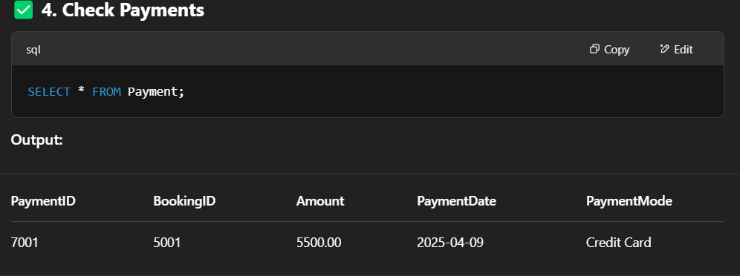
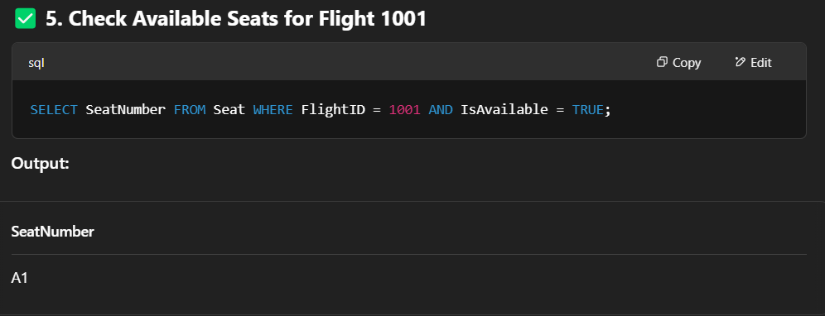
Screenshots

Slide 11
qU eries.sqI
43ebnvdy4
CREATE TABLE Customer ( CustomerID PRIMARY KEY, Name VARCHAR(i00),
Contact VARCHAR(15) ,
Ena i L VARCHAR( 100}
CREATE TABLE F1 ight (
F Llgnt ID INT PRIMARY kEY, At 11ne VARCHAR(100) , Sourc e VARCHAR( 50} ,
De st1n at ion VARCHAR( 50) , Dep a°t ureTime DATETIME , Ar ivalTime DATETIME
- CREATE TABLE Booking ( Book1ngID INT PRIMARY KEY,
CustomerID IN*, FL1gnt ID INT,
Book1ngDate DATE ,
Stat us VARCHAR( 20} ,
FOREIGN KEY (Custome ID) REFERENCES Customer(CustomerID), FOREIGN KEY (FlightID) REFERENCES Flight(*1ightID)
CREATE TABLE Payment (
Payment I D INT PRIfñARY KEY,
Book1ngl D INT,
Amount DECIMAL(10,2),
PaymentDate DATE , PaymentMode VARCHAR( 20) ,
FOREIGN KEY (Book1ngI D) REFERENCEs Books ng{BookingID)
- CREATE TABLE Seat ( Seat ID INT, FlightID INT,
seatNumber VARCHAR(IO), IsAvailable BOOLEAN,
PRIMARY KEY (5eatID, FlightID),
FOREIGN KEY (FlightID) REFERENCES Flight(FlightID)
INSERT INTO Custome VALUES (1, Smith , '98765#3210', 'alice@example.com');
INSERT INTO Flight VALUES (1001, 'Indigo',
'Mumbai', '2025-0d-15 08:00:00', '2025-04-15 10:00:00');
'Confirmed');
INSERT INTO Booking VALUES (5001, l, 1001,
INSERT INTO Payment VALUES (7001, 5001, 5500.00, '2025-0#-09', 'Credit Card');
INSERT INTO Seat VALUES (1, 1001, ' A1' , TRUE ) j

Slide 12
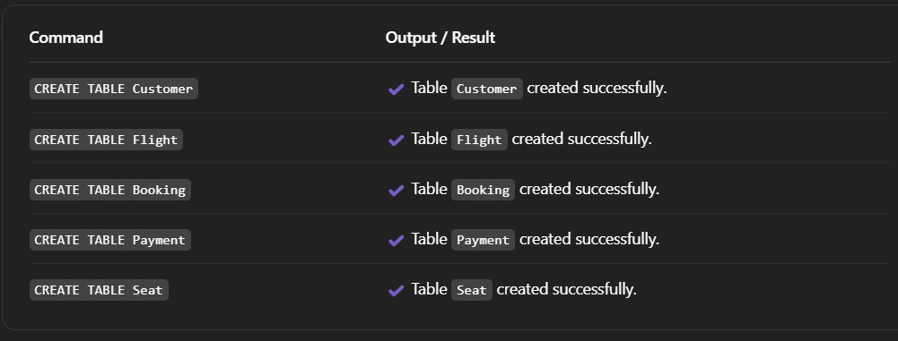
🔹 Conclusion
This Airline Reservation Management System demonstrates how a relational database can efficiently handle complex relationships and transactions. With modular entities and clear relationships, the system supports scalability, reliability, and secure access to data. This project can be the foundation for building a full-fledged airline booking application with web and mobile interfaces.

